Slide 1
CSP Solver Analysis
Constraint Satisfaction Problems:
Nonograms & Guest Seating
Mogage Nicolae • ICA 246/1

Slide 2
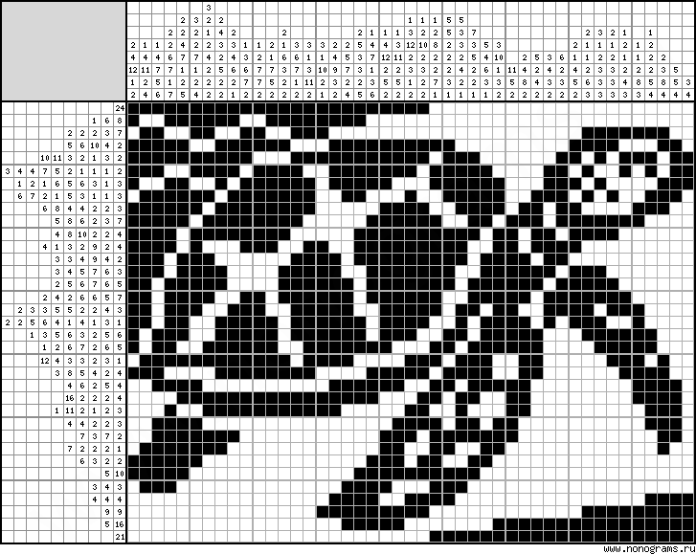
Problem Statement: Nonograms
What is a Nonogram?
A logic puzzle where cells in a grid must be colored (1) or left blank (0) according to numbers at the side of the grid.
Numbers indicate unbroken lines of filled squares in rows and columns.
Test Cases
Sizes: 9x9 to 35x40
Varying difficulty levels
Larger puzzles proved computationally challenging
Solved puzzles reveal shapes and images

Slide 3
Problem Statement: Guest Seating
Challenge
Arrange guests at tables while satisfying multiple constraints: table capacity, partner preferences, enemy conflicts, and political alignment.
Constraints
Political Score Rule
Table capacity limit
Each Guest receives a score from 1 to 10
Partner guests (same table)
Score difference ≤ 2: Same table
Enemy guests (different tables)
Score difference > 2: Different tables
Political score alignment
Test Generation
Difficulty Levels
Problems randomly created at runtime with configurable probabilities.
Varying probabilities create easy to hard problems.

Slide 4
Solutions: CSP Modeling
Nonograms
Guest Seating
Variables:
Variables:
Each row and column (M+N total)
Guests (G₁, G₂, ..., Gₙ)
Domains:
Domains:
Valid patterns satisfying clues
Tables {1, 2, ..., M}
Constraints:
Constraints:
Binary: row[c] = column[r] at intersections
Enemy, Partner, Political, Capacity
Solution Methods: AC-3 & PC-4 (reduction) + Forward Checking, GBJ, GENET (search)

Slide 5
Experiments & Implementation
Methods Tested
Time Limits
AC-3 + {FC, BT, GBJ, GENET}
10 min: Reduction
PC-4 + {FC, BT, GBJ, GENET}
15 min: Search
Standalone: FC, BT, GBJ, GENET
Core Data Structures
Metrics Tracked
Variable: Mutable domains, conflict tracking
Total time, Nodes visited, Constraint checks, Backtracks
Constraint: Abstract satisfaction logic
CSP: Variables, constraints, adjacency map

Slide 6
Results: Nonograms Performance
🏆 Best Performers
AC-3: 1-15ms on most puzzles
GENET: 21-510ms, solved 9/10
Forward Checking: Good on smaller
❌ Poor Performers
CHART PLACEHOLDER
Performance Comparison
Backtracking & GBJ: Timeout 7/9
PC-4: OutOfMemory (6/10)
Long reduction, minimal benefit
Key Insight
AC-3 drastically reduces search space, enabling near-instant solving

Slide 7
Results: Guest Seating Performance
🏆 Clear Winner
Forward Checking: Fastest at all scales
12 vars: 0ms | 200 vars: 5-35ms
600 vars: 109ms | 1000 vars: 296ms
GENET Performance
CHART PLACEHOLDER
Scalability Analysis
Second best (0-1585ms)
AC-3 + GENET: Competitive option
Scaling Behavior
> 5000 constraints: BT & GBJ timeout
AC-3: Long preprocess, no search gain

Slide 8
Conclusions
No Universal Solution
Algorithm selection must be guided by problem characteristics. No single approach dominates all scenarios.
Geometric Problems
Complex General Problems
Use: AC-3
Use: Forward Checking
Excellent for dense grids
Best scalability
Drastically reduces search space
Consistent performance
Near-instant solving
Handles large constraint sets
Avoid
Avoid
Backtracking & GBJ: Poor scalability
GENET: Good general solver, but may get stuck in local minima
PC-4: High overhead, memory issues

